Slide 1
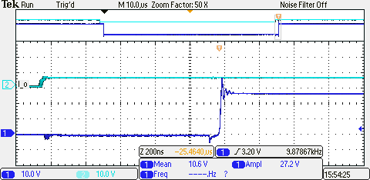
DRAIN SOURCE VOLTAGE Under No Current
Driver Input Signal
Vds

Slide 2
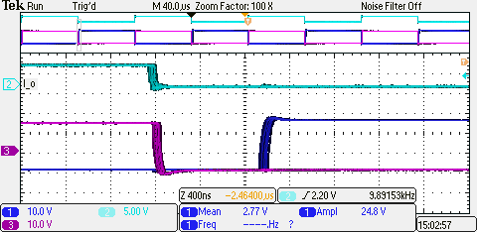
GATE – SOURCE VOLTAGE of High Side and Low Side MOSFET
Vgs High Side
Vgs Low Side
DeadTime
1μs

